Slide 1

SD-WAN ON FORTIGATE
This project demonstrates the deployment of an enterprise SD-WAN solution using FortiGate firewalls at both the Headquarters and Branch sites. The solution integrates multiple WAN links, VLAN segmentation, and intelligent traffic steering to enhance network performance and availability.

Slide 2
Introduction
Modern enterprises require reliable and scalable WAN connectivity for distributed branches. Traditional WAN models depend on static routing and single links, which cause performance bottlenecks, limited resiliency, and higher costs. SD-WAN enables dynamic path selection, centralized control, and enhanced link utilization by leveraging multiple connections simultaneously.
• Deploy FortiGate devices at HQ and Branch sites • Configure VLAN-based WAN links to Routers R1 and R2 • Implement SD-WAN Zones and Members with dual WAN paths • Create Performance SLA probes to monitor latency, jitter, and packet loss • Apply SD-WAN rules for intelligent path steering

Slide 3
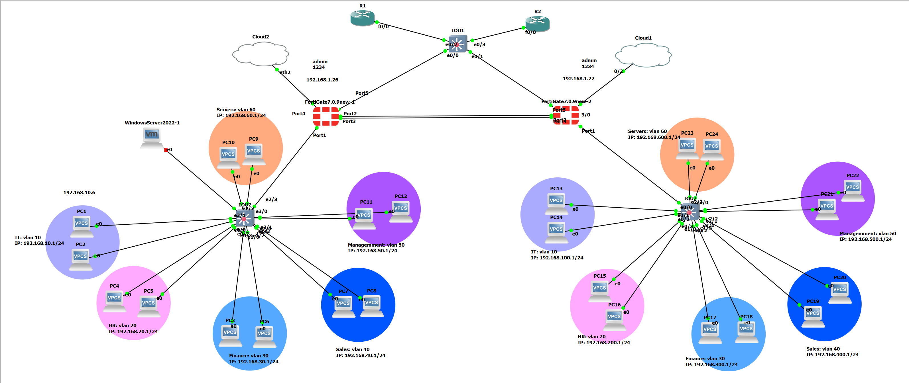
Network Topology
The topology consists of two sites: HQ using the 192.168.x.x addressing scheme and the Branch using 172.16.x.x. Both sites have six departmental VLANs. Two routers (R1 and R2) provide dual uplinks over VLAN 10 and VLAN 20. FortiGate devices at each site connect to an L2 switch carrying both VLANs, enabling SD-WAN to evaluate multiple paths between the sites.

Slide 4
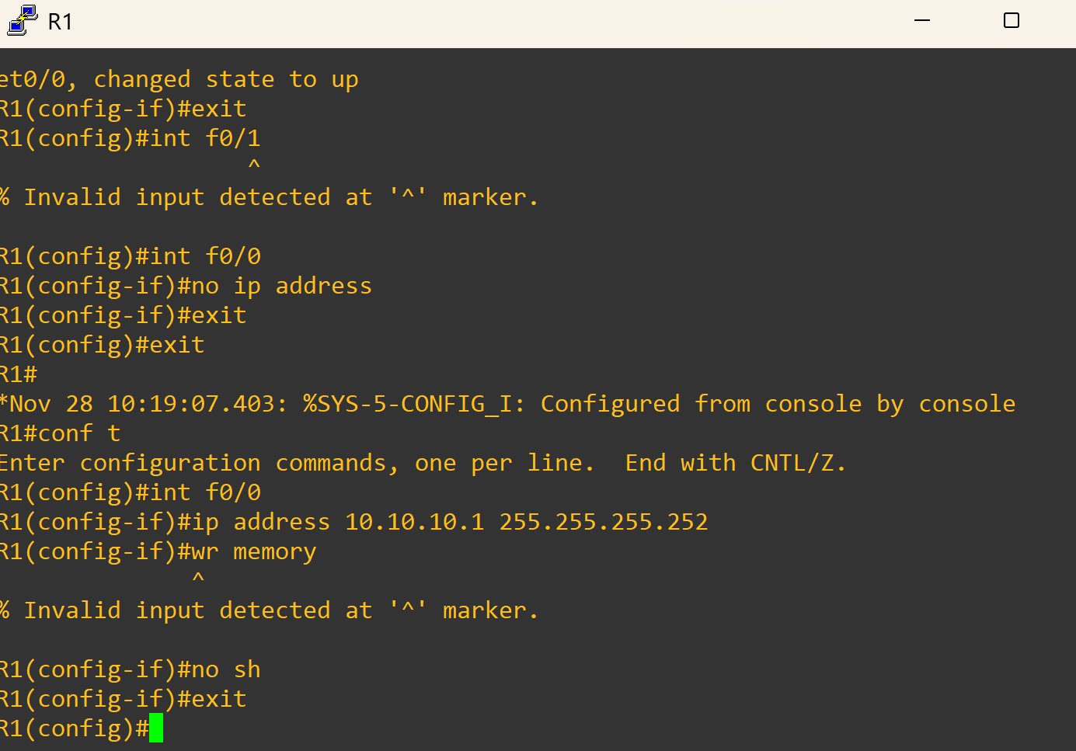
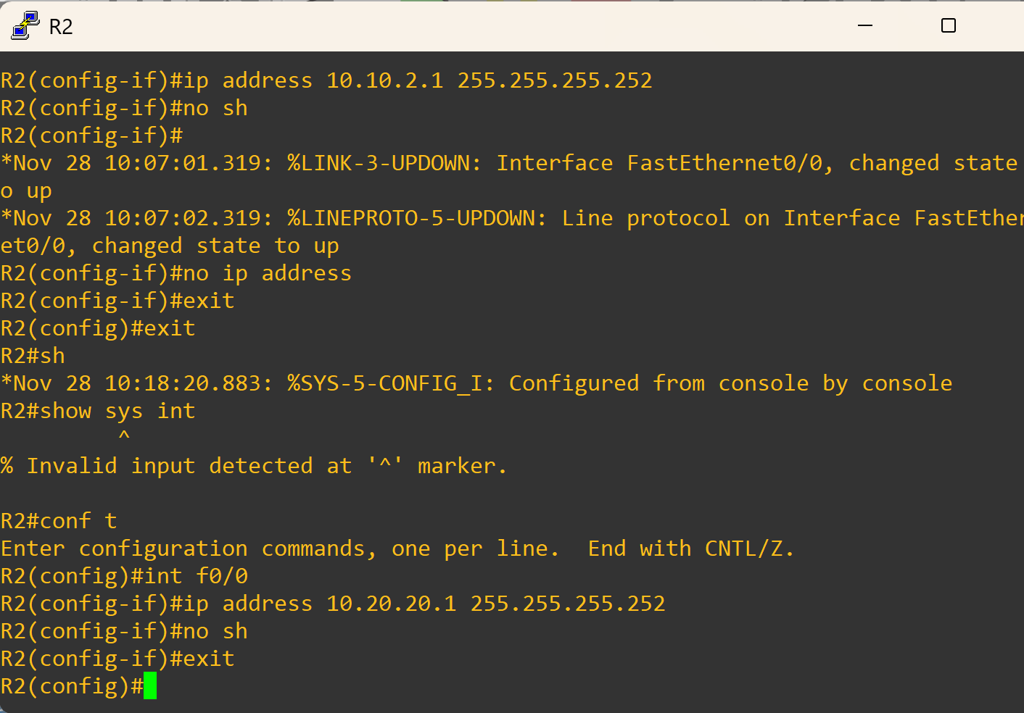
WAN Interface Configuration
On both FortiGate devices, we created VLAN-based WAN sub-interfaces for each router connection. At HQ: WAN_R1 (10.10.10.2/30) and WAN_R2 (10.20.20.2/30). At Branch: WAN_R1_BR and WAN_R2_BR with matching subnets. Ping tests confirmed successful Layer 3 connectivity and communication between the firewalls and routers.

Slide 5
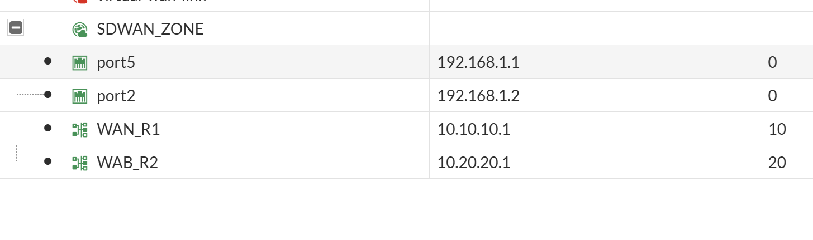
SD-WAN Zone & Members
We created SD-WAN zones at both sites (HQ_SD-WAN and BR_SD-WAN). We added both WAN interfaces as SD-WAN members and assigned their gateways (10.10.10.1 and 10.20.20.1). This allows the FortiGate to treat the multiple WAN links as a single logical interface and enables dynamic path selection.

Slide 6
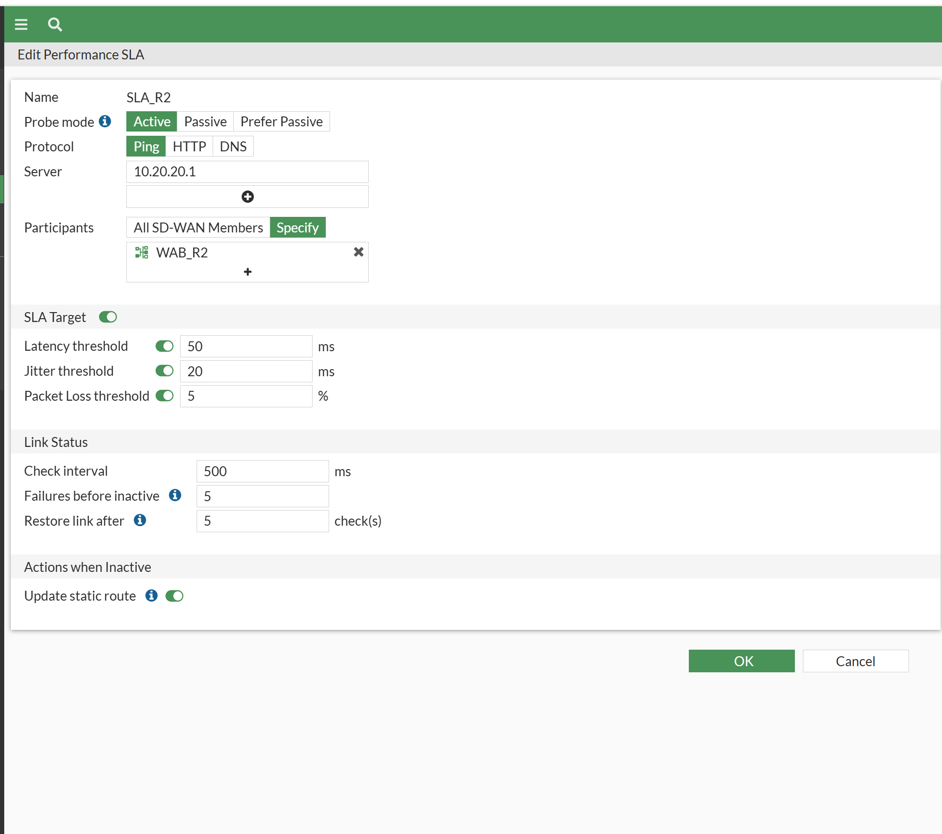
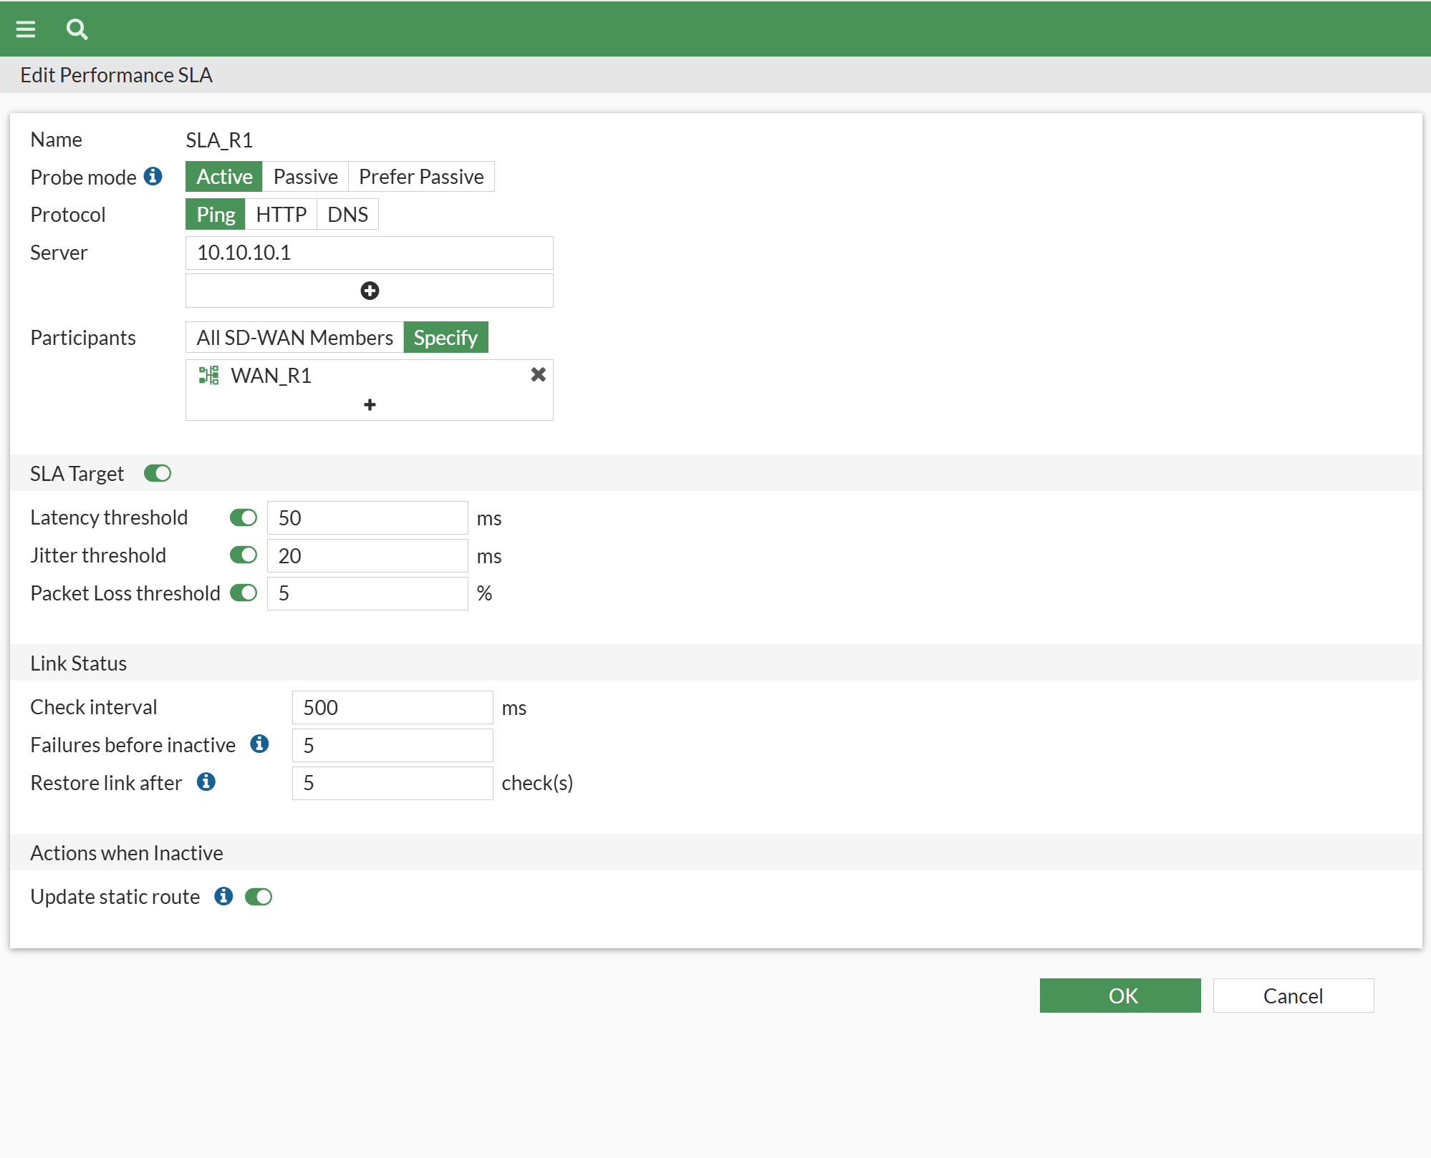
Performance SLA Configuration
We configured two SLA health checks at each site, each monitoring a different WAN link. SLA_BR_R1 tracks traffic over Router R1 and SLA_BR_R2 monitors Router R2. Thresholds for latency, jitter, and packet loss were defined to ensure link quality. When a link exceeds thresholds, SD-WWAN marks it unstable and uses the alternate link.

Slide 7
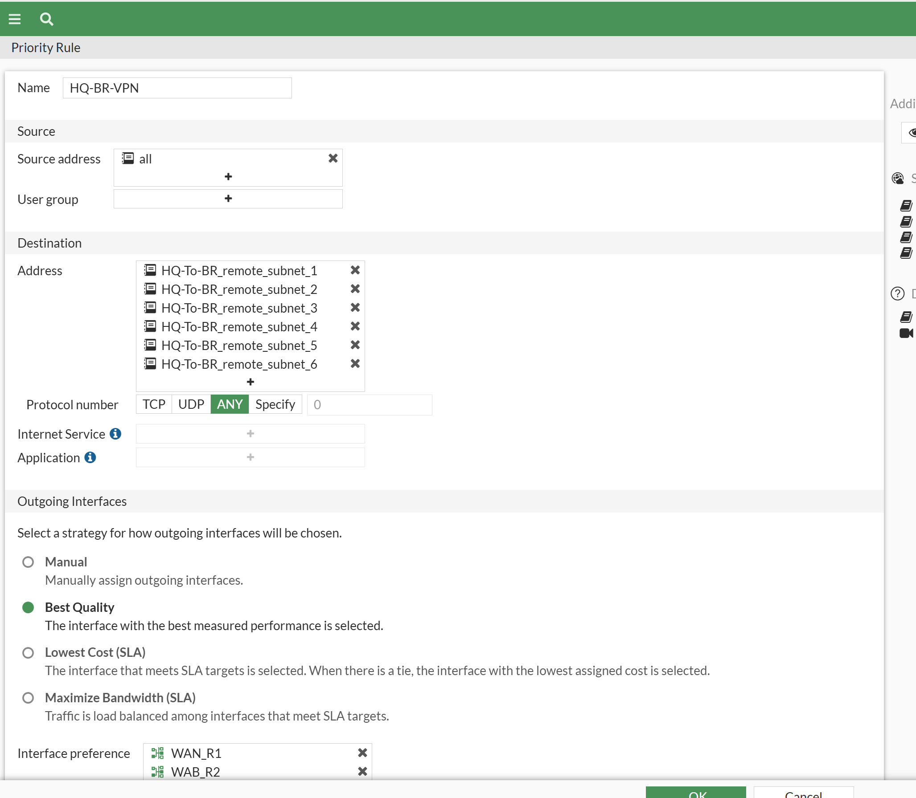
SD-WAN Rule
We applied SD-WAN routing rules with the “Best Quality” strategy. The rule selects the optimal WAN path based on live SLA performance. If WAN_R1 shows lower latency and packet loss, it becomes the active link; if its performance degrades, traffic shifts automatically to WAN_R2 without user disruption.

Slide 8
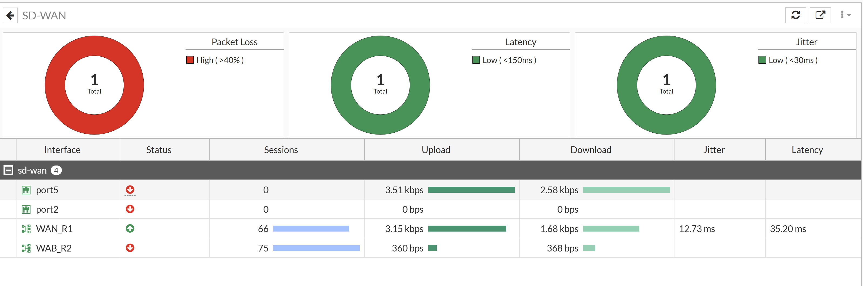
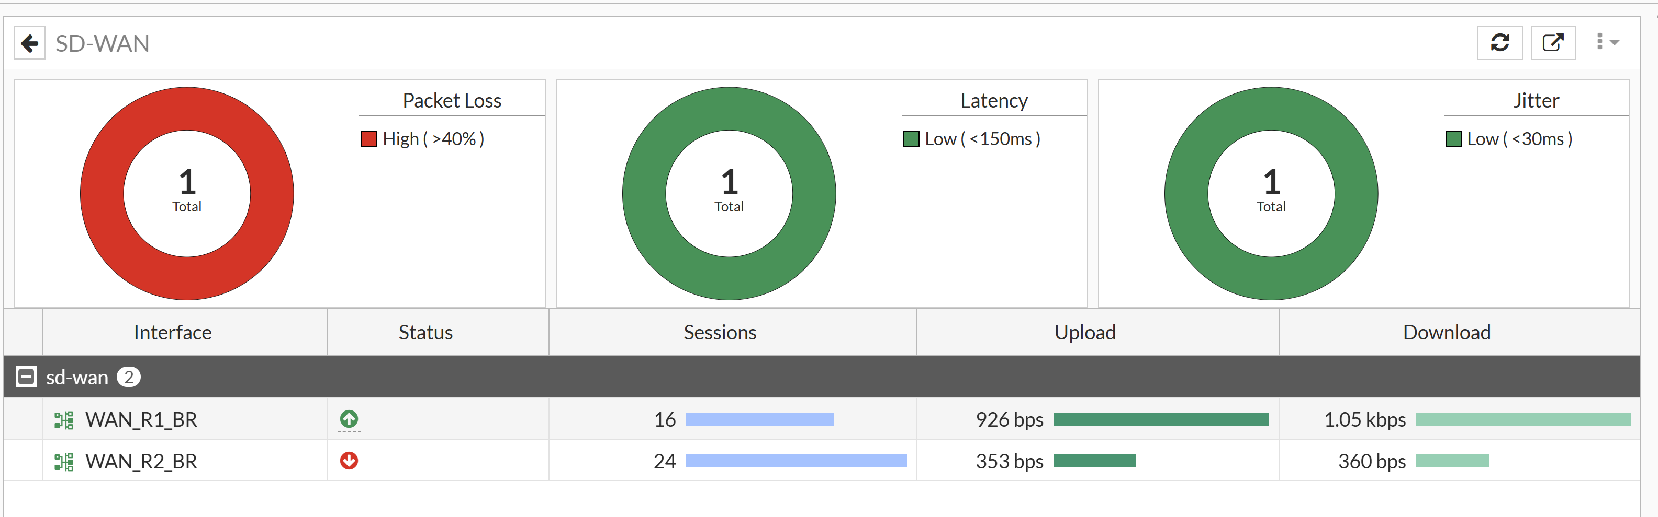
Testing & Validation
We tested connectivity between HQ and Branch using ICMP and monitored link behavior. When we manually shut down Router R1, SD-WAN detected the loss of SLA metrics and routed traffic through Router R2 instantly. When R1 came back online, the link selection recalculated based on SLA values.

Slide 9
Conclusion
The SD-WAN deployment successfully enabled intelligent WAN path selection, redundancy, and simplified management across dual FortiGate firewalls. The project proves the efficiency of Fortinet SD-WAN for scalable, secure, and responsive enterprise networks. It provides full resiliency and prepares the network for future expansion and additional applications.

